Slide 1
Artificial Intelligence: Representation and Problem Solving
Multi-agent Systems (3): Other Games and Solution Concepts
15-381 / 681
Instructors: Fei Fang (This Lecture) and Dave Touretzky
feifang@cmu.edu
Wean Hall 4126

Slide 2
Recap
A game in normal form consists of
  Set of players $N=\left\{1..n\right\}$
  Set of strategies $S=\prod_{i}{S_{i}}$
  Payoffs / Utility functions $u_{i}:S→R$
  Players move simultaneously
Solution Concepts | How to Find/Compute
Dominant Strategy Equilibrium | Brute Force Enumeration
Pure Strategy Nash Equilibrium | Iterative Elimination, Brute Force Enumeration
Mixed Strategy Nash Equilibrium | Same as Minimax/Maximin for two-player zero-sum games Support Enumeration Method for two-player general-sum games
Minimax/Maximin | Linear Programming

Slide 3
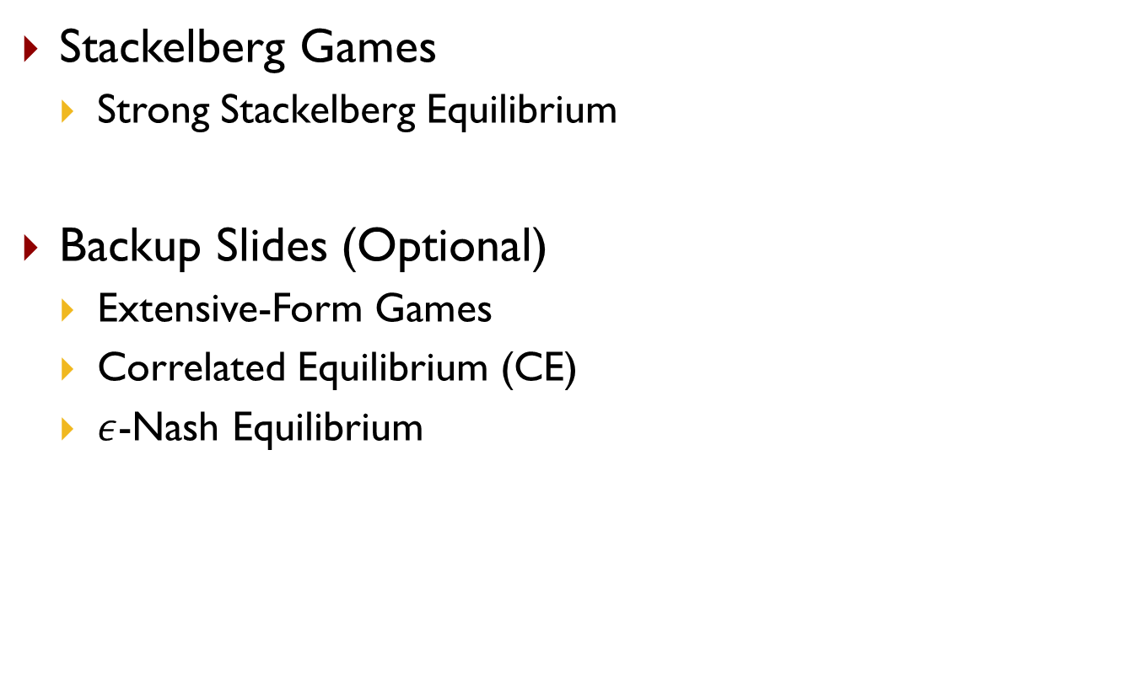
Outline
Stackelberg Games
  Strong Stackelberg Equilibrium
Backup Slides (Optional)
  Extensive-Form Games
  Correlated Equilibrium (CE)
  $ε$-Nash Equilibrium

Slide 4
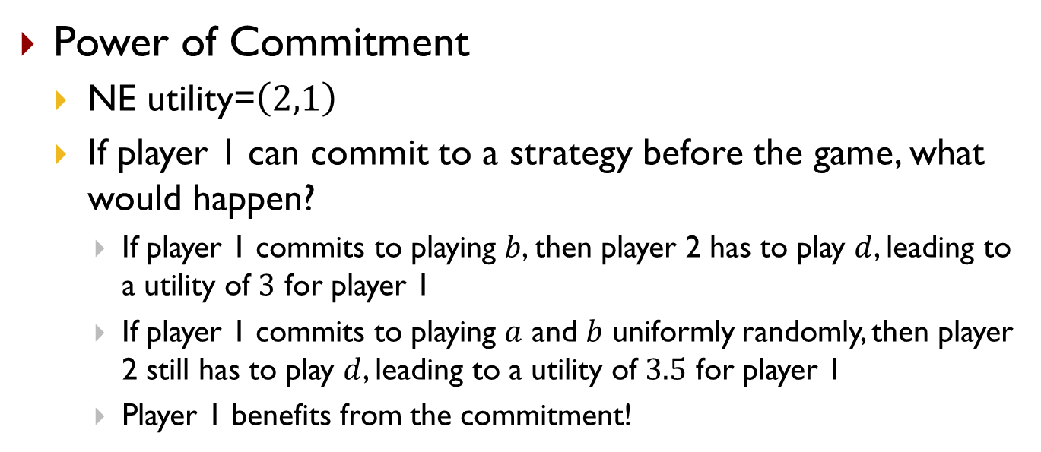
Stackelberg Game
Power of Commitment
  NE utility=$\left(2,1\right)$
  If player 1 can commit to a strategy before the game, what would happen?
    If player 1 commits to playing $b$, then player 2 has to play $d$, leading to a utility of $3$ for player 1
    If player 1 commits to playing $a$ and $b$ uniformly randomly, then player 2 still has to play $d$, leading to a utility of $3.5$ for player 1
    Player 1 benefits from the commitment!
Player 2
 | c | d
a | 2,1 | 4,0
b | 1,0 | 3,2
Player 1

Slide 5
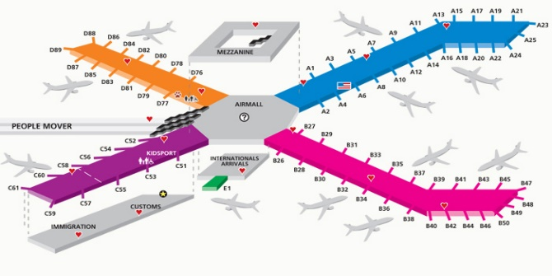
Example: Airport Security
Limited resource allocation
Adversary surveillance
Adversary
 | Target #1 | Target #2
Target #1 | 5, -3 | -1, 1
Target #2 | -5, 4 | 2, -1
Defender
Notes:
Here is an example game abstracting a simple scenario in infrastructure security domain. There are two targets, which could be two terminals at an airport, or airsides in the case of Pittsburgh International Airport. The first player in the game is the defender. He has limited defensive resources and can only choose to protect one target every day. The second player, the adversary, can choose a target to attack. The numbers in this table show the payoffs for the players, green for the defender and red for the adversary. If the defender is protecting target 1 when the attacker attacks target 1, the attacker would fail, the defender will get a reward of 5 and the attacker gets a penalty of 3.

Slide 6
Example: Airport Security
Limited resource allocation
Adversary surveillance
Adversary
 | Target #1 | Target #2
Target #1 | 5, -3 | -1, 1
Target #2 | -5, 4 | 2, -1
Defender
Notes:
On the other hand, if the defender is protecting target 2 when the attacker attacks target 1, the attack would be successful, then the defender will get a penalty and the attacker gets a reward.
Actually the players do not move simultaneously. Before an attack, the adversary will conduct surveillance for a long time and then choose which target to attack and a rational attacker will choose a target that would lead to the best outcome for him. For example, if the defender protects target 2 every day, this can be easily observed by the attacker and he will choose to attack target 1.

Slide 7
Example: Airport Security
Randomization make defender unpredictable
Defender: Commits to mixed strategy
Adversary: Conduct surveillance and responds
Adversary
 | Target #1 | Target #2
Target #1 | 5, -3 | -1, 1
Target #2 | -5, 4 | 2, -1
55.6%
Defender
44.4%
Notes:
So it’s important for the defender to randomize and keep the adversary guessing. He can choose a mixed strategy, and flip a biased coin every morning to decide which target to protect. The adversary may observe this mixed strategy, but he will not know which target will be protected in a particular day in the future. If the attacker is perfectly rational, he will best respond to the defender’s strategy and choose a target that leads to the highest expected utility for him. The defender’s task is to find the optimal strategy that leads to the highest expected utility for him, assuming the attacker will best respond. This kind of game is called Stackelberg Security Game and the task for us is to find the optimal defender strategy, that is, the best way to randomize.
For this particular game, this is the optimal defender strategy. Now question, can anyone tell me why this is the optimal defender strategy?
AttEU1=AttEU2=0.11
DefEU1=0.56, DefEU2=0.332

Slide 8
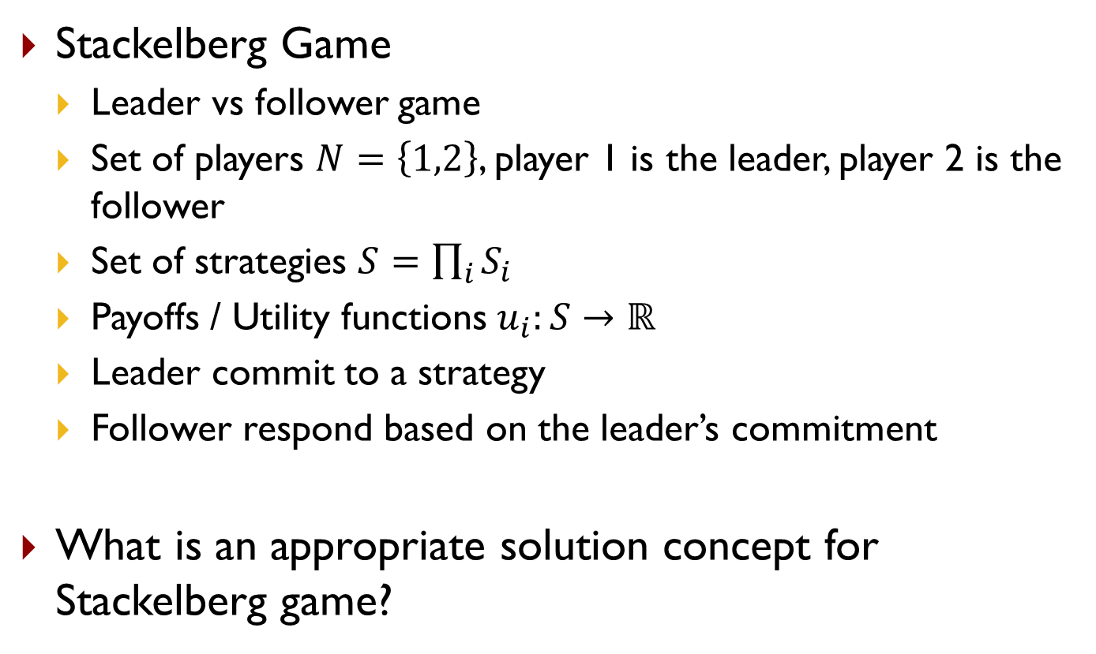
Stackelberg Game
Stackelberg Game
  Leader vs follower game
  Set of players $N=\left\{1,2\right\}$, player 1 is the leader, player 2 is the follower
  Set of strategies $S=\prod_{i}{S_{i}}$
  Payoffs / Utility functions $u_{i}:S→ℝ$
  Leader commit to a strategy
  Follower respond based on the leader’s commitment
What is an appropriate solution concept for Stackelberg game?

Slide 9















Stackelberg Game
 | c | d
a | 2,1 | 4,0
b | 1,0 | 3,2
Player 1
Power of Commitment
  What is the best strategy for Player 1?
  Player 1 commits to playing $a$ with probability $p$. What is the best response of player 2 and the utility profile?
$$EU^{2}(p,BR(p))$$
$$EU^{1}(p,BR(p))$$
$$2$$
$$1.5$$
$$3$$
$$1$$
$$2$$
$$0.5$$
$$1$$
$$p$$
$$p$$
$$0$$
$$0$$
$$1$$
$$1$$

Slide 10









Stackelberg Game
 | c | d
a | 2,1 | 4,0
b | 1,0 | 3,2
Player 1
Power of Commitment
  What is the best strategy for Player 1?
  Player 1 commits to playing $a$ with probability $p$. What is the best response of player 2 and the utility profile?
$$EU^{2}(p,BR(p))$$
$$EU^{1}(p,BR(p))$$
$$2$$
$$\frac{11}{3}$$
$$EU_{d}^{2}=p∗0+\left(1−p\right)∗2$$
$$1.5$$
$$3$$
$$p∗4+\left(1−p\right)∗3$$
$$1$$
$$EU_{c}^{2}=p∗1+\left(1−p\right)∗0$$
$$2$$
$$2$$
$$\frac{2}{3}$$
$$\frac{5}{3}$$
$$p∗2+\left(1−p\right)∗1$$
$$0.5$$
$$1$$
$$p$$
$$p$$
$$0$$
$$0$$
$$\frac{2}{3}$$
$$1$$
$$\frac{2}{3}$$
$$1$$
$p∗1+\left(1−p\right)∗0=p∗0+\left(1−p\right)∗2$. So $p=\frac{2}{3}$ is the transition point

Slide 11
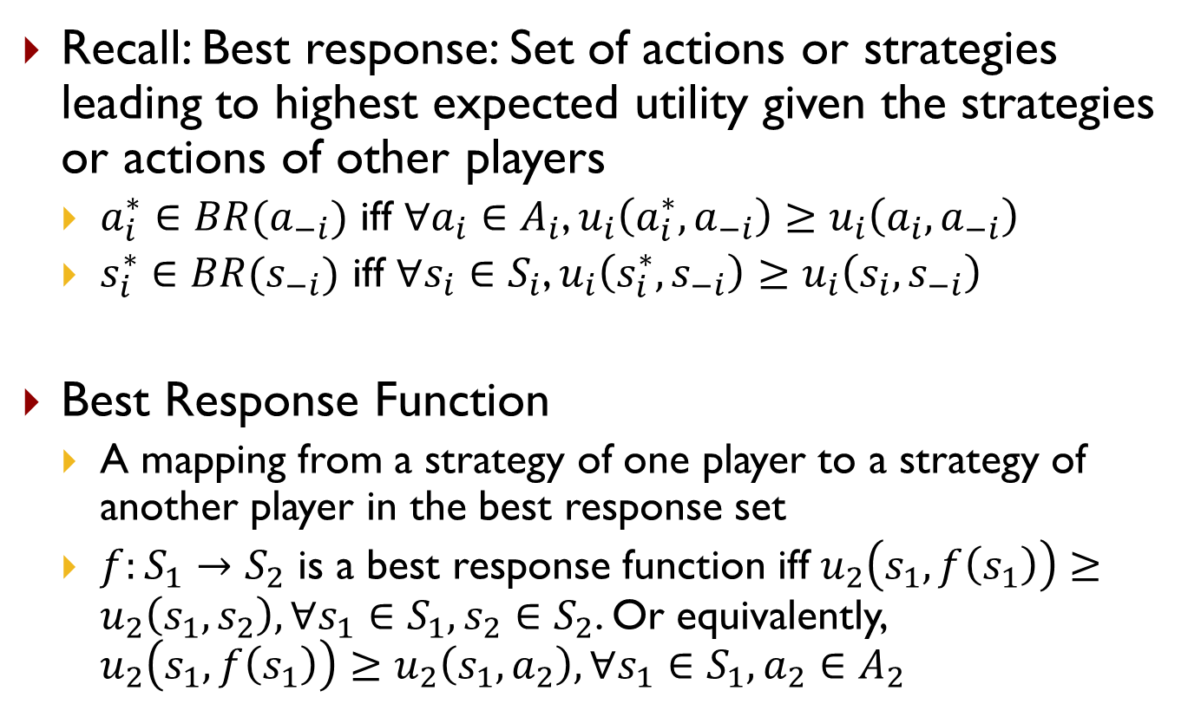
Best Response Function
Recall: Best response: Set of actions or strategies leading to highest expected utility given the strategies or actions of other players
  $a_{i}^{∗}∈BR(a_{−i})$ iff $∀a_{i}∈A_{i}$, $u_{i}\left(a_{i}^{∗},a_{−i}\right)≥u_{i}\left(a_{i},a_{−i}\right)$
  $s_{i}^{∗}∈BR(s_{−i})$ iff $∀s_{i}∈S_{i}$, $u_{i}\left(s_{i}^{∗},s_{−i}\right)≥u_{i}\left(s_{i},s_{−i}\right)$
Best Response Function
  A mapping from a strategy of one player to a strategy of another player in the best response set
  $f:S_{1}→S_{2}$ is a best response function iff $u_{2}\left(s_{1},f\left(s_{1}\right)\right)≥u_{2}\left(s_{1},s_{2}\right),∀s_{1}∈S_{1},s_{2}∈S_{2}$. Or equivalently, $u_{2}\left(s_{1},f\left(s_{1}\right)\right)≥u_{2}\left(s_{1},a_{2}\right),∀s_{1}∈S_{1},a_{2}∈A_{2}$

Slide 12
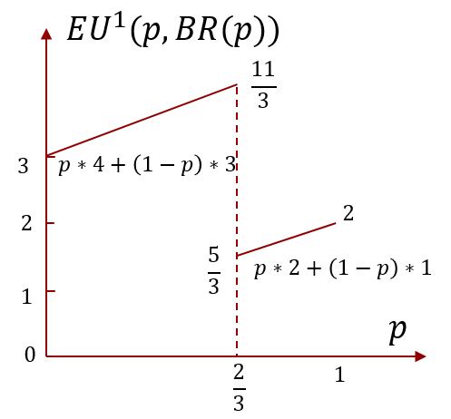
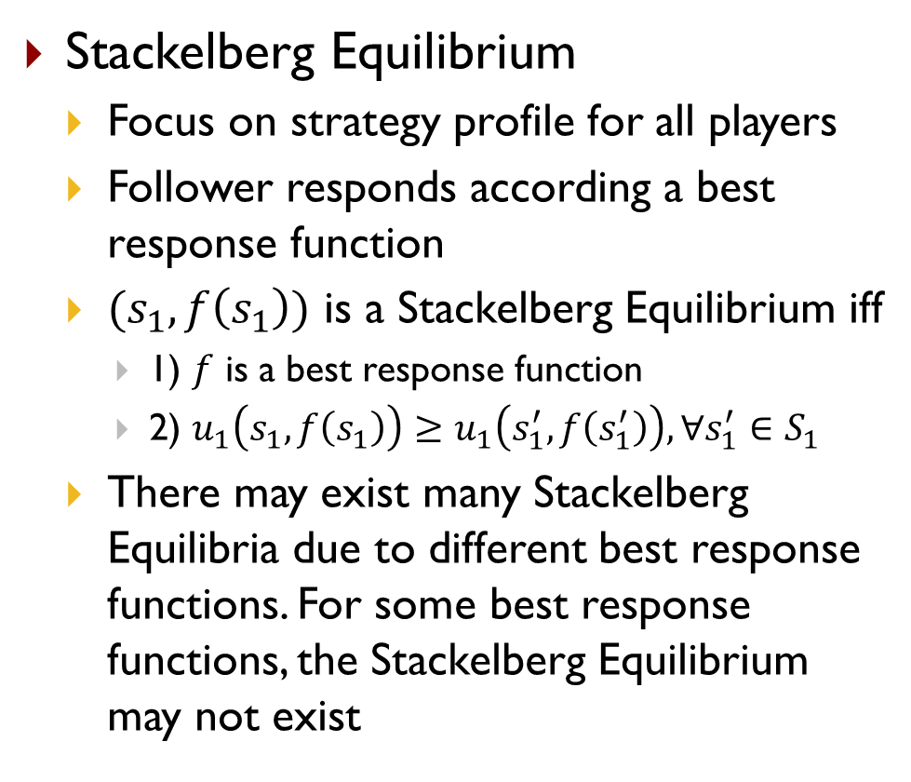
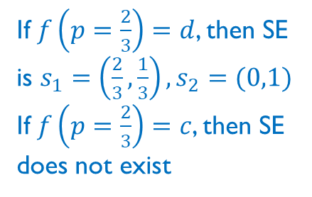
Stackelberg Equilibrium
 | c | d
a | 2,1 | 4,0
b | 1,0 | 3,2
Player 1
Stackelberg Equilibrium
  Focus on strategy profile for all players
  Follower responds according a best response function
  $(s_{1},f\left(s_{1}\right))$ is a Stackelberg Equilibrium iff
    1) $f$ is a best response function
    2) $u_{1}\left(s_{1},f\left(s_{1}\right)\right)≥u_{1}\left(s_{1}^{′},f\left(s_{1}^{′}\right)\right),∀s_{1}^{′}∈S_{1}$
  There may exist many Stackelberg Equilibria due to different best response functions. For some best response functions, the Stackelberg Equilibrium may not exist
If $f\left(p=\frac{2}{3}\right)=d$, then SE is $s_{1}=\left(\frac{2}{3},\frac{1}{3}\right),s_{2}=(0,1)$
If $f\left(p=\frac{2}{3}\right)=c$, then SE does not exist

Slide 13
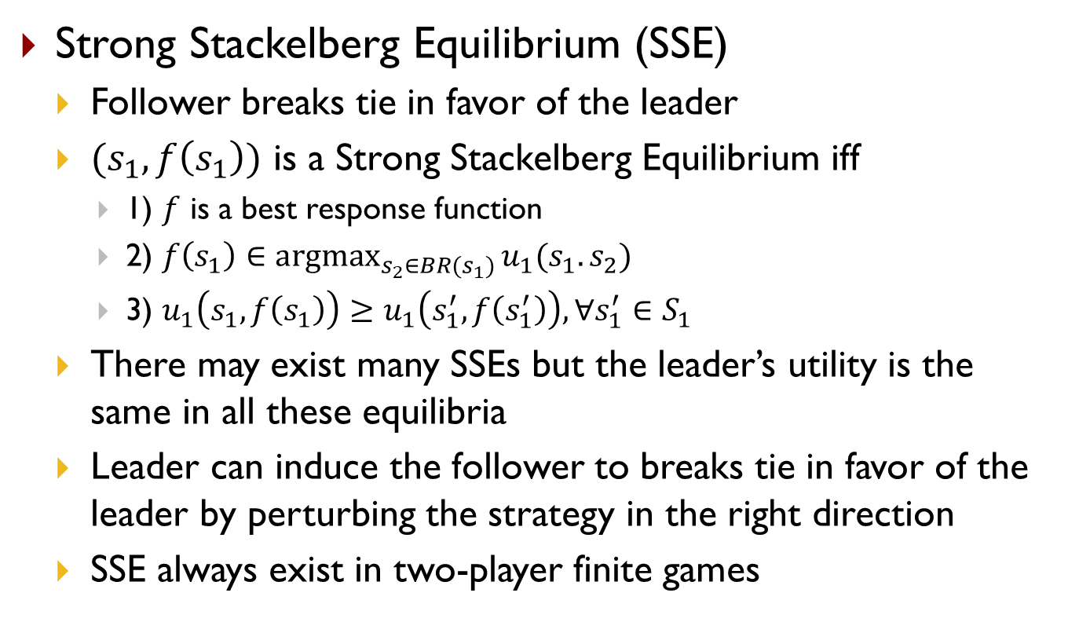
Strong Stackelberg Equilibrium
Strong Stackelberg Equilibrium (SSE)
  Follower breaks tie in favor of the leader
  $(s_{1},f\left(s_{1}\right))$ is a Strong Stackelberg Equilibrium iff
    1) $f$ is a best response function
    2) $f\left(s_{1}\right)∈\underset{s_{2}∈BR(s_{1})}{argmax}{u_{1}(s_{1}.s_{2})}$
    3) $u_{1}\left(s_{1},f\left(s_{1}\right)\right)≥u_{1}\left(s_{1}^{′},f\left(s_{1}^{′}\right)\right),∀s_{1}^{′}∈S_{1}$
  There may exist many SSEs but the leader’s utility is the same in all these equilibria
  Leader can induce the follower to breaks tie in favor of the leader by perturbing the strategy in the right direction
  SSE always exist in two-player finite games

Slide 14
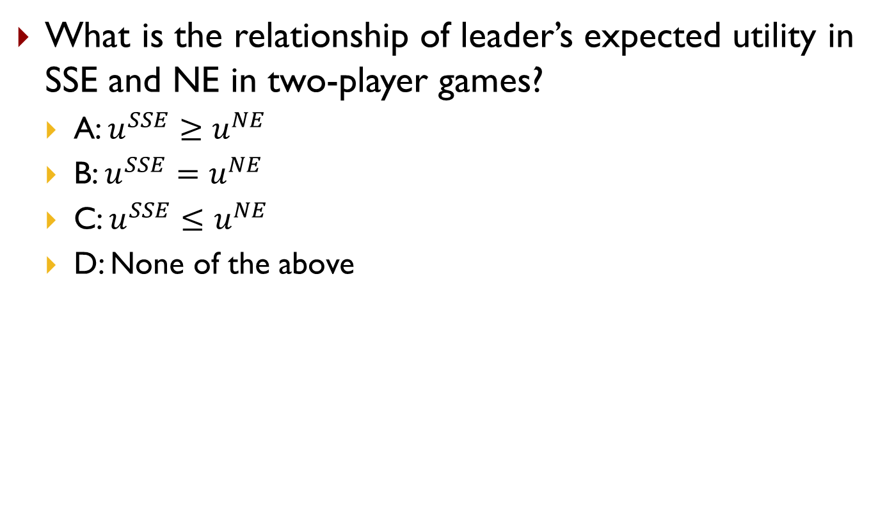
Quiz 1
What is the relationship of leader’s expected utility in SSE and NE in two-player games?
  A: $u^{SSE}≥u^{NE}$
  B: $u^{SSE}=u^{NE}$
  C: $u^{SSE}≤u^{NE}$
  D: None of the above
Notes:
𝑢^𝑆𝑆𝐸≥𝑢^𝑁𝐸

Slide 15
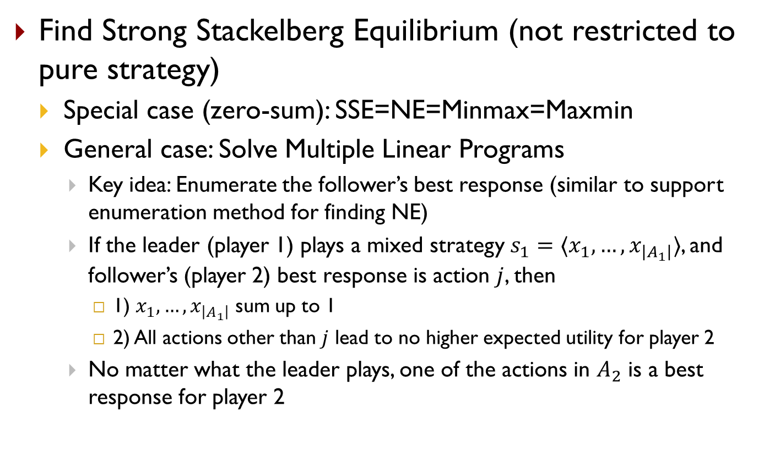
Compute Strong Stackelberg Equilibrium
Find Strong Stackelberg Equilibrium (not restricted to pure strategy)
  Special case (zero-sum): SSE=NE=Minmax=Maxmin
  General case: Solve Multiple Linear Programs
    Key idea: Enumerate the follower’s best response (similar to support enumeration method for finding NE)
    If the leader (player 1) plays a mixed strategy $s_{1}=〈x_{1},…,x_{\left|A_{1}\right|}〉$, and follower’s (player 2) best response is action $j$, then
      1) $x_{1},…,x_{\left|A_{1}\right|}$ sum up to 1
      2) All actions other than $j$ lead to no higher expected utility for player 2
    No matter what the leader plays, one of the actions in $A_{2}$ is a best response for player 2

Slide 16

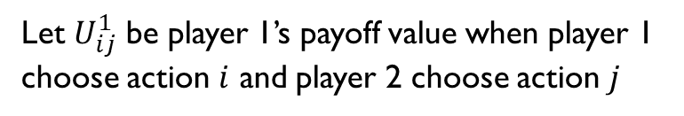

Compute Strong Stackelberg Equilibrium
Solve Multiple Linear Programs
Let $U_{ij}^{1}$ be player 1’s payoff value when player 1 choose action $i$ and player 2 choose action $j$
For each $j=1..|A_{2}|$, solve the following LP
$$\max_{x}{\sum_{i}{x_{i}U_{ij}^{1}}}$$
s.t.
$$\sum_{i}{x_{i}}=1$$
$$x_{i}≥0$$
$$\sum_{i}{x_{i}U_{ij}^{2}}≥\sum_{i}{x_{i}U_{ij^{′}}^{2}},∀j^{′}∈A_{2}$$
Then pick the solution with the highest optimal objective value among all $j$’s

Slide 17
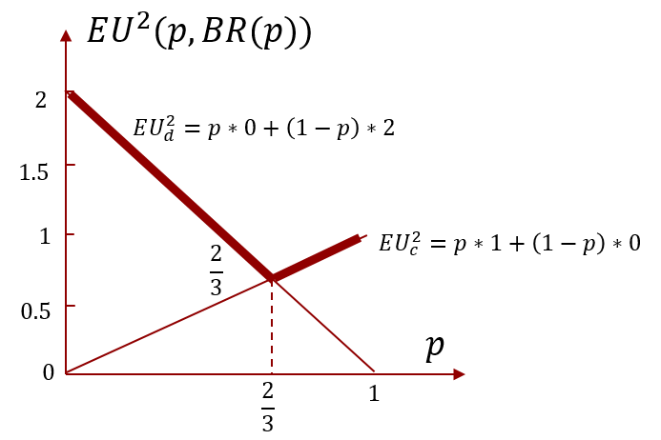



Multiple LP
 | c | d
a | 2,1 | 4,0
b | 1,0 | 3,2
Player 1
Let $s_{1}=〈p,1−p〉$
If BR is $c$, solve
If BR is $d$, solve

Slide 18
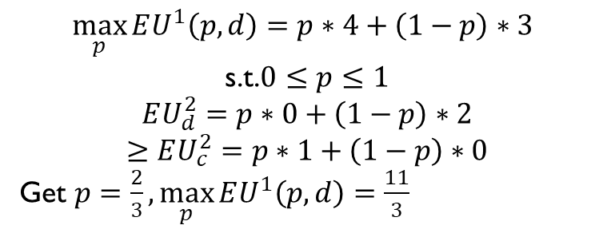
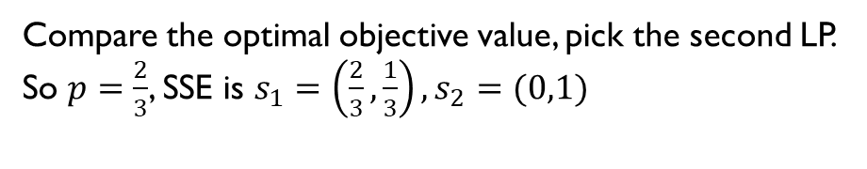
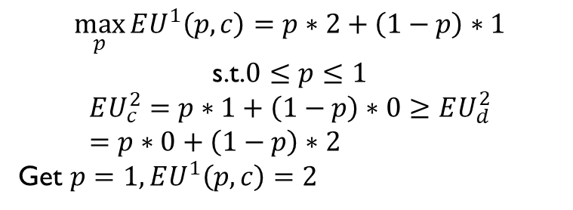
Multiple LP
 | c | d
a | 2,1 | 4,0
b | 1,0 | 3,2
Player 1
Let $s_{1}=〈p,1−p〉$
If BR is $c$, solve
If BR is $d$, solve
$$\max_{p}{EU^{1}\left(p,c\right)=p∗2+\left(1−p\right)∗1}$$
s.t.$0≤p≤1$
$$EU_{c}^{2}=p∗1+\left(1−p\right)∗0≥EU_{d}^{2}=p∗0+\left(1−p\right)∗2$$
Get $p=1, EU^{1}\left(p,c\right)=2$
$$\max_{p}{EU^{1}\left(p,d\right)=p∗4+\left(1−p\right)∗3 }$$
s.t.$0≤p≤1$
$$EU_{d}^{2}=p∗0+\left(1−p\right)∗2$$
$$≥EU_{c}^{2}=p∗1+\left(1−p\right)∗0$$
Get $p=\frac{2}{3},\max_{p}{EU^{1}\left(p,d\right)}=\frac{11}{3}$
Compare the optimal objective value, pick the second LP.
So $p=\frac{2}{3}$, SSE is $s_{1}=\left(\frac{2}{3},\frac{1}{3}\right),s_{2}=(0,1)$

Slide 19

Example: Airport Security
Let $s_{1}=〈p,1−p〉$
If BR is attack target #1, solve
If BR is attack target #2, solve
Adversary
 | Target #1 | Target #2
Target #1 | 5, -3 | -1, 1
Target #2 | -5, 4 | 2, -1
55.6%
Defender
44.4%

Slide 20
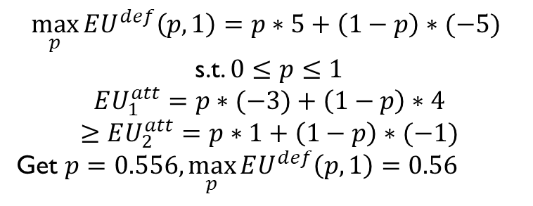
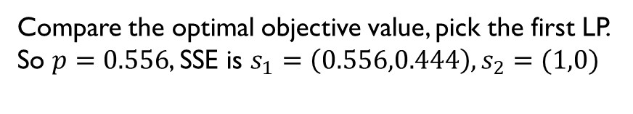
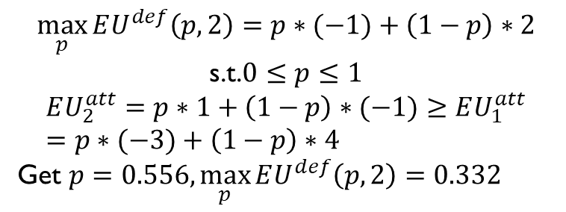
Example: Airport Security
Let $s_{1}=〈p,1−p〉$
If BR is attack target #1, solve
If BR is attack target #2, solve
$$\max_{p}{EU^{def}\left(p,1\right)=p∗5+\left(1−p\right)∗(−5) }$$
s.t. $0≤p≤1$
$$EU_{1}^{att}=p∗(−3)+\left(1−p\right)∗4$$
$$≥EU_{2}^{att}=p∗1+\left(1−p\right)∗(−1)$$
Get $p=0.556,\max_{p}{EU^{def}\left(p,1\right)}=0.56$
$$\max_{p}{EU^{def}\left(p,2\right)=p∗(−1)+\left(1−p\right)∗2}$$
s.t.$0≤p≤1$
$$EU_{2}^{att}=p∗1+\left(1−p\right)∗(−1)≥EU_{1}^{att}=p∗(−3)+\left(1−p\right)∗4$$
Get $p=0.556,\max_{p}{EU^{def}\left(p,2\right)}=0.332$
Compare the optimal objective value, pick the first LP.
So $p=0.556$, SSE is $s_{1}=\left(0.556,0.444\right),s_{2}=(1,0)$
Adversary
 | Target #1 | Target #2
Target #1 | 5, -3 | -1, 1
Target #2 | -5, 4 | 2, -1
55.6%
Defender
44.4%

Slide 21
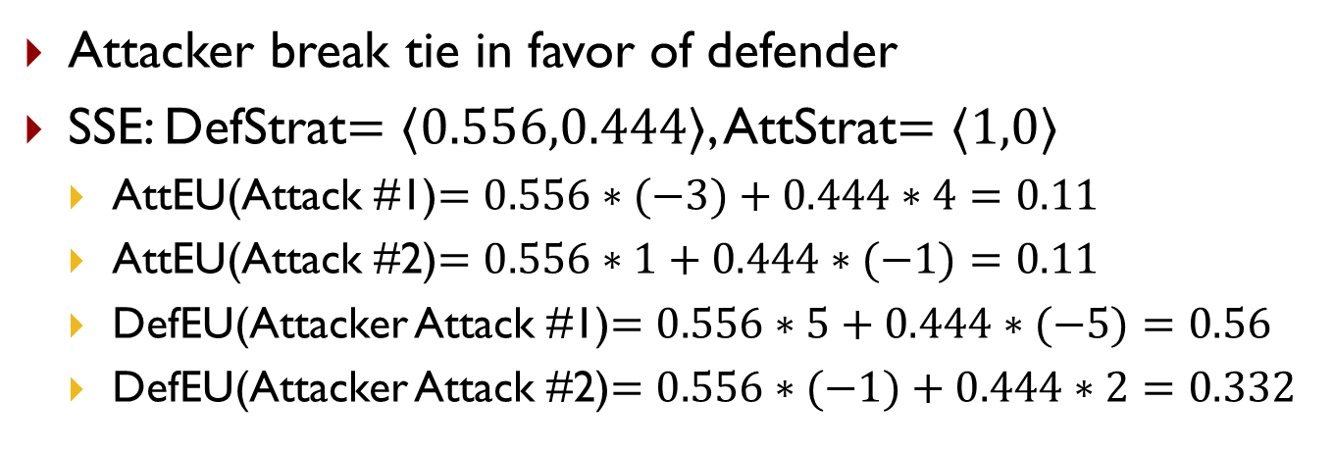
Example: Airport Security
Attacker break tie in favor of defender
SSE: DefStrat$=〈0.556,0.444〉$, AttStrat$=〈1,0〉$
  AttEU(Attack #1)$=0.556∗(−3)+0.444∗4=0.11$
  AttEU(Attack #2)$=0.556∗1+0.444∗(−1)=0.11$
  DefEU(Attacker Attack #1)$=0.556∗5+0.444∗(−5)=0.56$
  DefEU(Attacker Attack #2)$=0.556∗(−1)+0.444∗2=0.332$
Adversary
 | Target #1 | Target #2
Target #1 | 5, -3 | -1, 1
Target #2 | -5, 4 | 2, -1
55.6%
Defender
44.4%

Slide 22
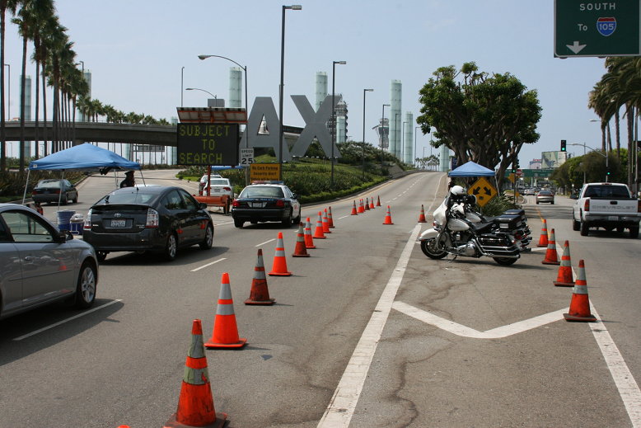
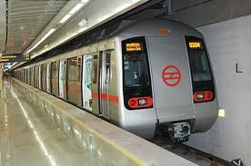




Real-World Applications
Physical Infrastructure
Transportation Networks
Cyber Systems
Environmental Resources
Endangered Wildlife
Fisheries

Slide 23

Real-World Applications
Notes:
These research challenges are not fully resolved yet, but we have made some attempt to address them. Here is an example work where we compute the optimal defender strategy to protect a set of moving targets with multiple mobile resources, and the solution is actually deployed in the field by USCG for protecting the Staten Island Ferry using escort boats like this since April 2013. Our solution has changed their maneuver in conducting patrols.

Slide 24
Summary
Stackelberg Game
  Strong Stackelberg Equilibrium
    Solve Multiple LPs

Slide 25
Reading
Textbook Chapter 17.5

Slide 26
Additional Resources (optional)
Online course
  https://www.youtube.com/user/gametheoryonline

Slide 27
Acknowledgment
Some slides are borrowed from previous slides made by Tuomas Sandholm, Ariel Procaccia, Zico Kolter and Zack Rubinstein

Slide 28
Backup Slides
Not required

Slide 29
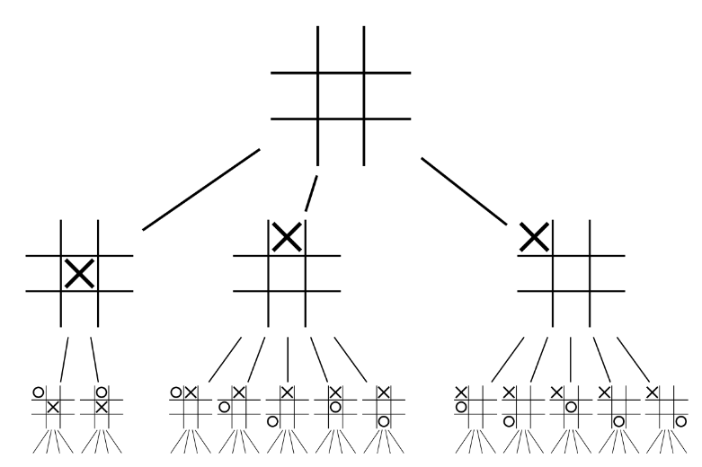







Extensive-Form Games
A game in extensive-form
  Timing, Sequence of move
  Can be represented by a game tree with information sets
Perfect information vs Imperfect information
Tic-Tac-Toe
Myerson Poker
Nature
K
Q
$$\frac{1}{2}$$
$$\frac{1}{2}$$
Ann
Raise
Check
Raise
Check
Beth
fold
call
fold
call
$$1, −1$$
$$−1, 1$$
$$2, −2$$
$$1, −1$$
$$−2, 2$$
$$1, −1$$

Slide 30
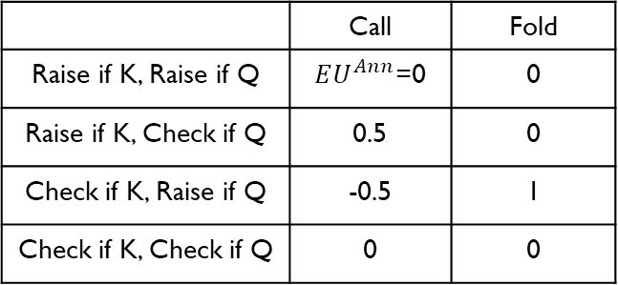
Extensive-Form Games
Repeated games with finite horizon and no discount factor can be viewed as EFGs
  Repeated Prisoner’s Dilemma
  Repeated Rock-Paper-Scissors
A game in extensive form can be converted into a game in normal form
Nature
K
Q
$$\frac{1}{2}$$
$$\frac{1}{2}$$
Beth
Ann
 | Call | Fold
Raise if K, Raise if Q | $EU^{Ann}$=0 | 0
Raise if K, Check if Q | 0.5 | 0
Check if K, Raise if Q | -0.5 | 1
Check if K, Check if Q | 0 | 0
Raise
Check
Raise
Check
Beth
Ann
fold
call
fold
call
$$1, −1$$
$$−1, 1$$
$$2, −2$$
$$1, −1$$
$$−2, 2$$
$$1, −1$$

Slide 31
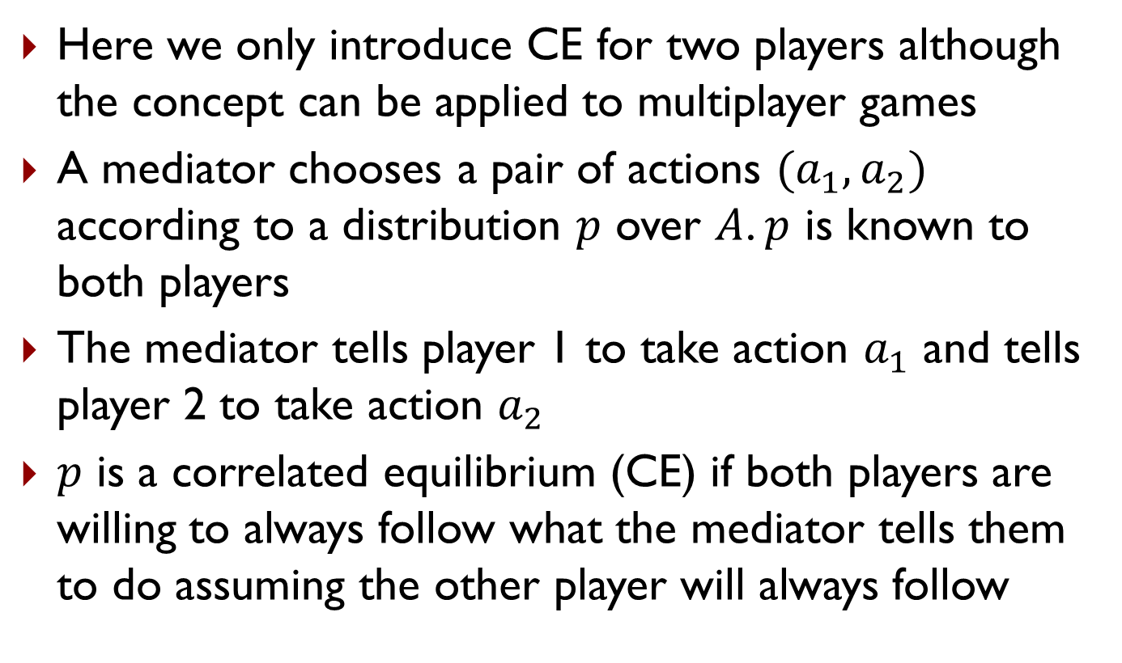
Correlated Equilibrium (CE)
Here we only introduce CE for two players although the concept can be applied to multiplayer games
A mediator chooses a pair of actions $(a_{1},a_{2})$ according to a distribution $p$ over $A$. $p$ is known to both players
The mediator tells player 1 to take action $a_{1}$ and tells player 2 to take action $a_{2}$
$p$ is a correlated equilibrium (CE) if both players are willing to always follow what the mediator tells them to do assuming the other player will always follow

Slide 32


Correlated Equilibrium (CE)
CE: Players have no incentive to deviate from what the mediator tells them to do
Game of Chicken
Berry
Berry
 | Football | Concert
Football | 2,1 | 0,0
Concert | 0,0 | 3,2
 | Dare | Chicken
Dare | 0,0 | 4,1
Chicken | 1,4 | 3,3
Alex
Alex
Mediator’s policy $p$
Mediator’s policy $p$
Berry
Berry
 | Football | Concert
Football | 0 | 0
Concert | 0 | 1
 | Dare | Chicken
Dare | 0 | 0
Chicken | 0 | 1
Alex
Alex
This is an CE, no player wants to deviate
This is not an CE, both players want to deviate

Slide 33

Correlated Equilibrium (CE)
$p$ can be a deterministic policy, which indicates a pure strategy profile. A deterministic $p$ is an CE iff the indicated pure strategy profile is an PSNE

Slide 34

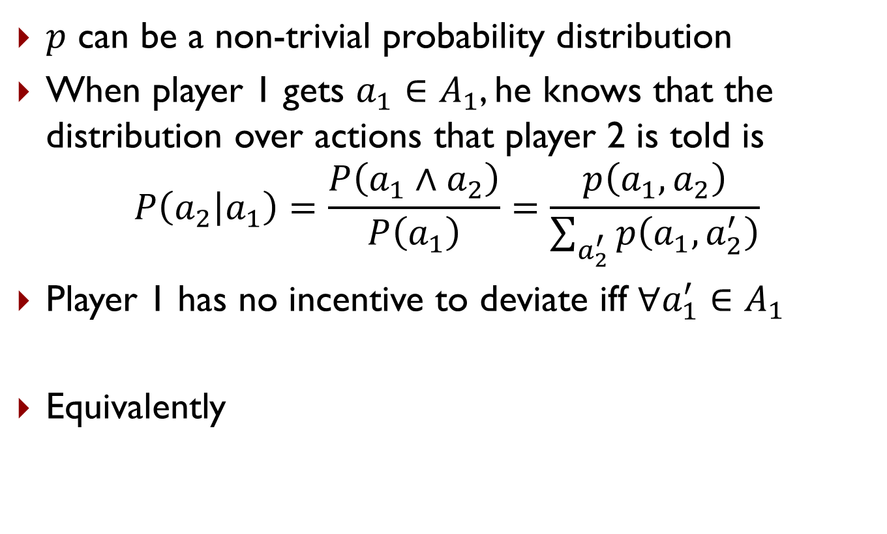

Correlated Equilibrium (CE)
$p$ can be a non-trivial probability distribution
When player 1 gets $a_{1}∈A_{1}$, he knows that the distribution over actions that player 2 is told is
$$P\left(a_{2} | a_{1}\right)=\frac{P\left(a_{1}∧a_{2}\right)}{P\left(a_{1}\right)}=\frac{p\left(a_{1},a_{2}\right)}{\sum_{a_{2}^{′}}{p\left(a_{1},a_{2}^{′}\right)}}$$
Player 1 has no incentive to deviate iff $∀a_{1}^{′}∈A_{1}$
Equivalently
$$\sum_{a_{2}}{P\left(a_{2} | a_{1}\right)}u_{1}\left(a_{1},a_{2}\right)≥\sum_{a_{2}}{P\left(a_{2} | a_{1}\right)}u_{1}\left(a_{1}^{′},a_{2}\right)$$
$$\sum_{a_{2}}{p\left(a_{1},a_{2}\right)}u_{1}\left(a_{1},a_{2}\right)≥\sum_{a_{2}}{p\left(a_{1},a_{2}\right)}u_{1}\left(a_{1}^{′},a_{2}\right)$$

Slide 35

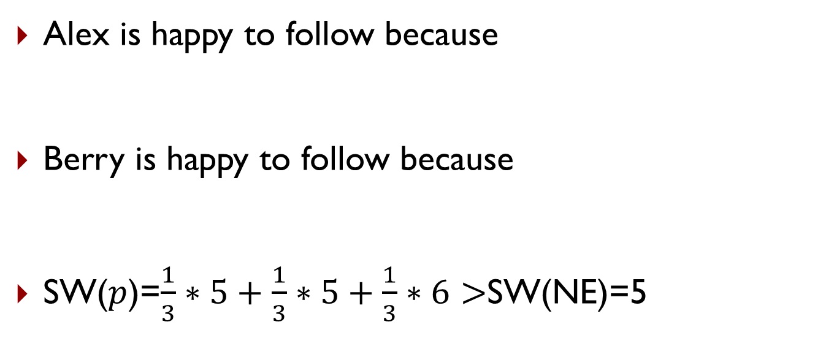
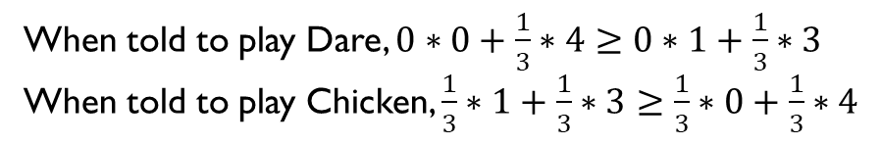
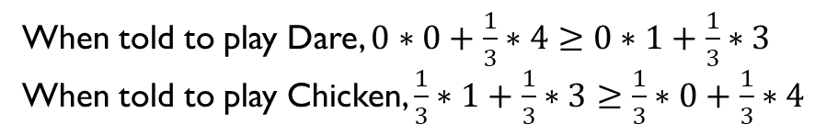
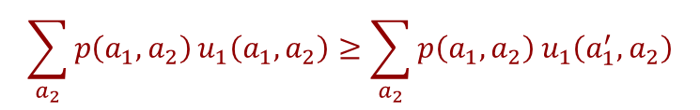
Correlated Equilibrium (CE)
$$\sum_{a_{2}}{p\left(a_{1},a_{2}\right)}u_{1}\left(a_{1},a_{2}\right)≥\sum_{a_{2}}{p\left(a_{1},a_{2}\right)}u_{1}\left(a_{1}^{′},a_{2}\right)$$
Alex is happy to follow because
Berry is happy to follow because
SW($p$)=$\frac{1}{3}∗5+\frac{1}{3}∗5+\frac{1}{3}∗6>$SW(NE)=5
When told to play Dare, $0∗0+\frac{1}{3}∗4≥0∗1+\frac{1}{3}∗3$
When told to play Chicken, $\frac{1}{3}∗1+\frac{1}{3}∗3≥\frac{1}{3}∗0+\frac{1}{3}∗4$
When told to play Dare, $0∗0+\frac{1}{3}∗4≥0∗1+\frac{1}{3}∗3$
When told to play Chicken, $\frac{1}{3}∗1+\frac{1}{3}∗3≥\frac{1}{3}∗0+\frac{1}{3}∗4$
Game of Chicken
Mediator’s policy $p$
Berry
Berry
 | Dare | Chicken
Dare | 0,0 | 4,1
Chicken | 1,4 | 3,3
 | Dare | Chicken
Dare | 0 | 1/3
Chicken | 1/3 | 1/3
Alex
Alex

Slide 36
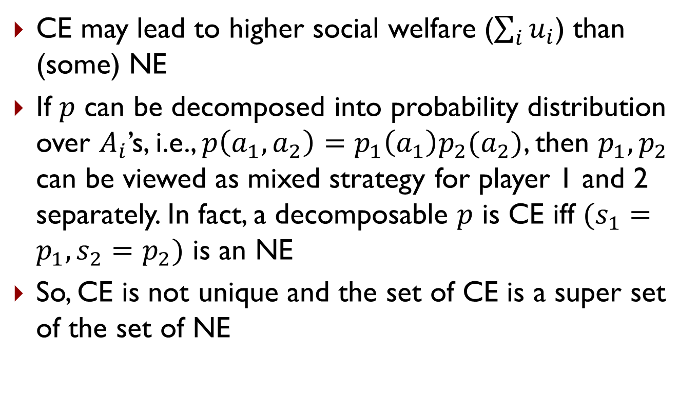
Correlated Equilibrium (CE)
CE may lead to higher social welfare ($\sum_{i}{u_{i}}$) than (some) NE
If $p$ can be decomposed into probability distribution over $A_{i}$’s, i.e., $p\left(a_{1},a_{2}\right)=p_{1}\left(a_{1}\right)p_{2}(a_{2})$, then $p_{1},p_{2}$ can be viewed as mixed strategy for player 1 and 2 separately. In fact, a decomposable $p$ is CE iff $(s_{1}=p_{1},s_{2}=p_{2})$ is an NE
So, CE is not unique and the set of CE is a super set of the set of NE

Slide 37
Compute CE
Zero-sum games: CE=NE=SSE=Minimax=Maximin
CE for bimatrix games can be computed through LP

Slide 38

Compute CE
Zero-sum games: CE=NE=SSE=Minimax=Maximin
CE for bimatrix games can be computed through LP
Find $p$
s.t.
$$\sum_{a_{2}}{p\left(a_{1},a_{2}\right)}u_{1}\left(a_{1},a_{2}\right)≥\sum_{a_{2}}{p\left(a_{1},a_{2}\right)}u_{1}\left(a_{1}^{′},a_{2}\right),∀a_{1},a_{1}^{′}$$
$$\sum_{a_{1}}{p\left(a_{1},a_{2}\right)}u_{1}\left(a_{1},a_{2}\right)≥\sum_{a_{1}}{p\left(a_{1},a_{2}\right)}u_{1}\left(a_{1},a_{2}^{′}\right),∀a_{2},a_{2}^{′}$$
$$\sum_{a_{1},a_{2}}{p\left(a_{1},a_{2}\right)}≤1$$
$$p\left(a_{1},a_{2}\right)≥0,∀a_{1},a_{2}$$

Slide 39

$ε$-NE
$ε$-Nash Equilibrium ($ε$-NE)
  Every player can gain at most $ε$ if deviate
  Formally
    $s=〈s_{1},…,s_{n}〉$ is $ε$-NE if $∀i, ∀s_{i}′∈S_{i}$, $u_{i}\left(s_{i}′,s_{−i}\right)−u_{i}\left(s_{i},s_{−i}\right)≤ε$

Slide 40
Some Take-Aways
There are various solution concepts in games
In two-player zero-sum games, many solution concepts lead to same strategy and utility
Finding NE/Minimax/Maximin/SSE can be formulated as one or more optimization problem and can be solved through mathematical programming

